Slide 1
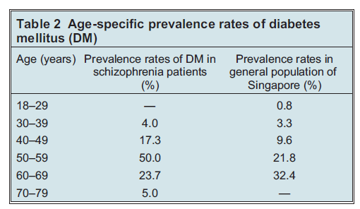
Diabetes
Schizophrenia
The estimated prevalence of diabetes mellitus in patients with schizophrenia is 10–15%
– i.e., twice that of the general population¹
Impaired glucose tolerance is also seen in patients with schizophrenia^{2,3}
Given the strength of the association, screening of patients with schizophrenia for the risk factors of diabetes is recommended³
Early detection of impaired glucose metabolism allows for timely interventions to prevent the development of diabetes, and may protect against long-term complications³
Age-specific prevalence rates of diabetes mellitus²
Patients with schizophrenia
General population
1. Correll. CNS Spectrums 2007;12(10 Suppl 17):12–20,35;
2. Subramaniam et al. Can J Psychiatry 2003;48(5):345–347;
3. Bushe & Holt. Br J Psychiatry 2004;184(Suppl. 47):s67–s71
Notes:
Individuals with schizophrenia are at greater risk than the general population of developing diabetes, or glucose intolerance.[Correll, 2007; Subramaniam et al., 2003] The association between schizophrenia and diabetes is thought to be partially explained by genetic factors.^{[Bushe & Holt, 2004]} However, it is also the case that patients with schizophrenia may display poor health behaviours, including having a poor diet and smoking, which are factors that may increase the risk of diabetes.^{[Bushe & Holt, 2004]} The strength of the association is such that patients with schizophrenia should be monitored for the risk factors of diabetes, allowing for early detection, and education of patients about the importance of a healthy lifestyle.^{[Bushe & Holt, 2004]}
References:
Bushe C, Holt R. Prevalence of diabetes and impaired glucose tolerance in patients with schizophrenia. Br J Psychiatry 2004; 184 (Suppl 47): s67–s71.
Correll CU. Balancing efficacy and safety in treatment with antipsychotics. CNS Spectr 2007; 12 (10 Suppl 17): 12–20, 35.
Subramaniam M, Chong S, Pek E. Diabetes mellitus and impaired glucose tolerance in patients with schizophrenia. Can J Psychiatry 2003; 48 (5): 345–347.

